Slide 1

ONLINE CLASS
GRAPH THEORY
BICTE $6^{TH}$ SEMESTER
2078/03/15
PRESENTED BY KALYAN DAHAL

Slide 2
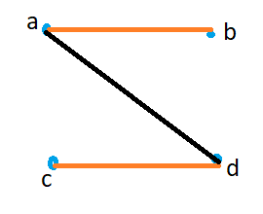
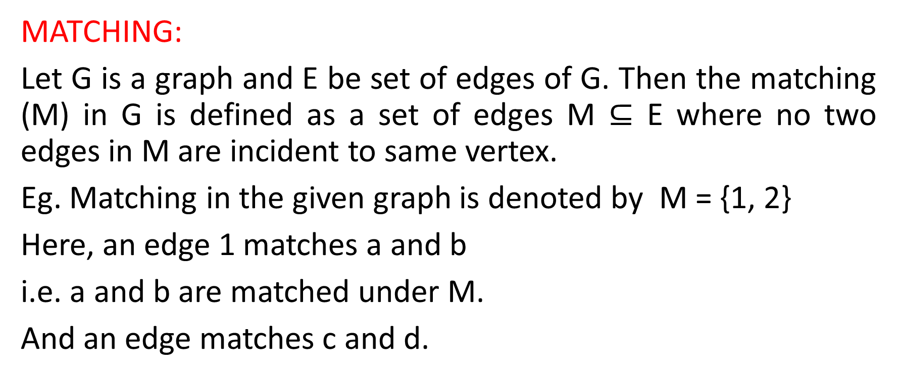
MATCHING
MATCHING:
Let G is a graph and E be set of edges of G. Then the matching (M) in G is defined as a set of edges M $⊆$ E where no two edges in M are incident to same vertex.
Eg. Matching in the given graph is denoted by M = {1, 2}
Here, an edge 1 matches a and b
i.e. a and b are matched under M.
And an edge matches c and d.

Slide 3
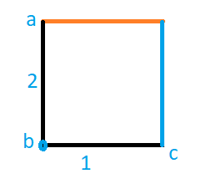
Continued….
Note:
The given graph G has no matching as there are two edges are incident to the same vertex.
The size of matching is given by the number of edges in the matching. The size of matching of given graph is 2.

Slide 4
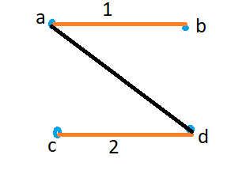
Continued….
3. Matching saturates a vertex:
The matching M is said to saturate a given vertex v in the graph G if one of the edges of M is incident to v. If there is no such an edge incident to v, the vertex v is called unsaturated by a matching.

Slide 5
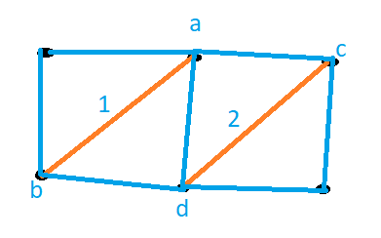
Continued….
4. In the given graph, there is a matching M of size 2 which has saturated 4 vertices.

Slide 6
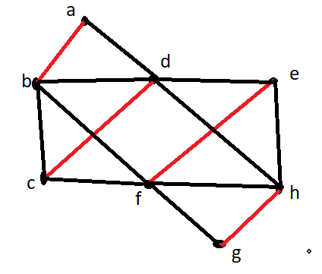
Perfect matching
Perfect matching:
Let G be a graph and M be a matching in G. M is called a perfect matching if M saturates all vertices.
Eg. The matching M in the given
graph G where M has saturated
all eight vertices of G. So, the
matching M is a perfect
matching graph S.

Slide 7
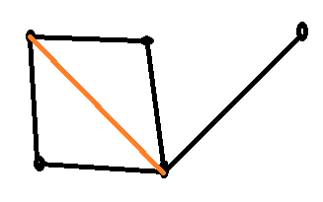
Maximal matching
Maximal matching:
Let G be a graph and M be a matching in G. The matching M is called maximal matching in G if M cannot be extended by adding more edges from G to M.
Here, M is maximal matching because it cannot
Be extended by adding any edge. If we add any
Edge to include either one remaining vertex,
The vertex which is previously occupied will
be connected in two edges.

Slide 8
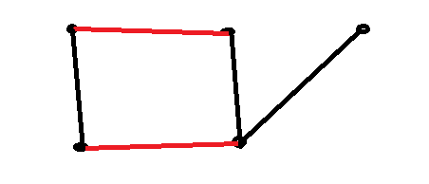
Maximum matching
Maximum matching:
Let G be a graph and M be a matching in G then a maximum matching is a matching with as many edges as possible.
Here, in the given graph, we can provide maximum two edges to maintain a matchingness.
Note:
A perfect matching is a maximum
matching but converse is not true.

Slide 9
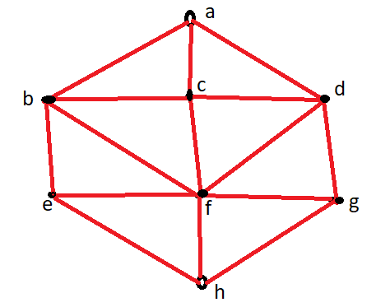
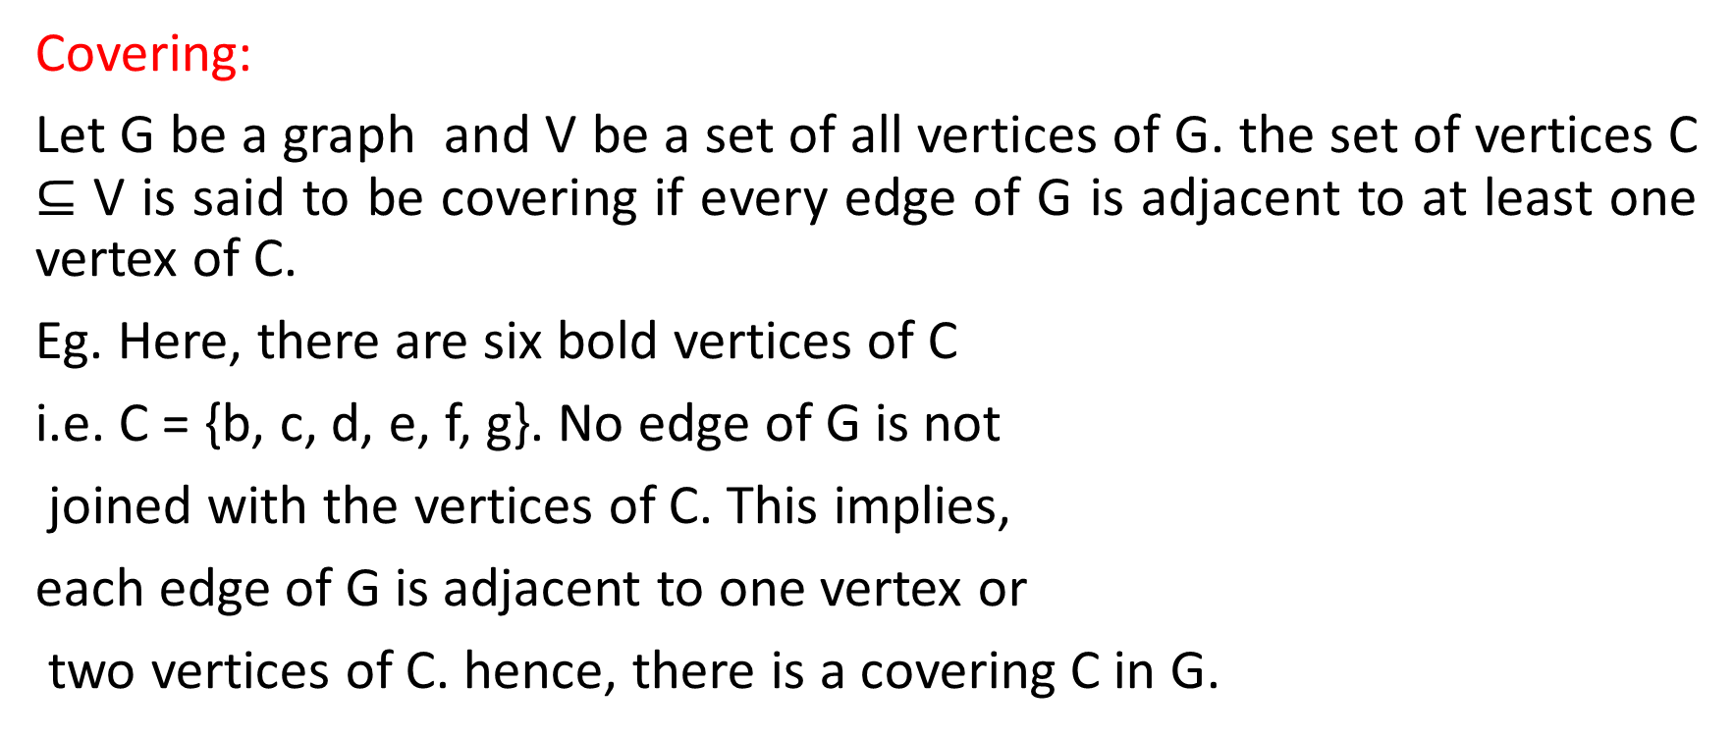
covering
Covering:
Let G be a graph and V be a set of all vertices of G. the set of vertices C $⊆$ V is said to be covering if every edge of G is adjacent to at least one vertex of C.
Eg. Here, there are six bold vertices of C
i.e. C = {b, c, d, e, f, g}. No edge of G is not
joined with the vertices of C. This implies,
each edge of G is adjacent to one vertex or
two vertices of C. hence, there is a covering C in G.

Slide 10
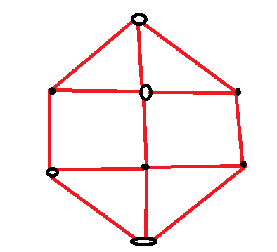



Continued…
Note:
The given figure has no covering as the edge $e_{1}$ and $e_{2}$ have no at least a vertex of C to be joined with.
$$e_{1}$$
$$e_{2}$$

Slide 11
Continued…
2. It is said that the covering C covers all the edges of G if each and every edge of G is joined with at least one vertex of C. Thus if we remove the vertices of C from G, then G will leave a graph with no edges.
3. The size of a covering C is determined by the number of vertices present in C.
The covering of the figure is 6.

Slide 12
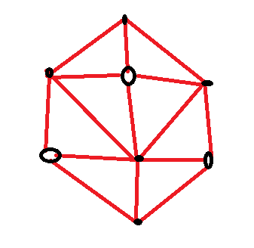
Continued…
4. A minimum covering:
The required number of minimum vertices to cover a given graph is called a minimum covering.
Here, the graph in given figure
can be covered by five number
of vertices.
So, the size of a covering is 5.

Slide 13
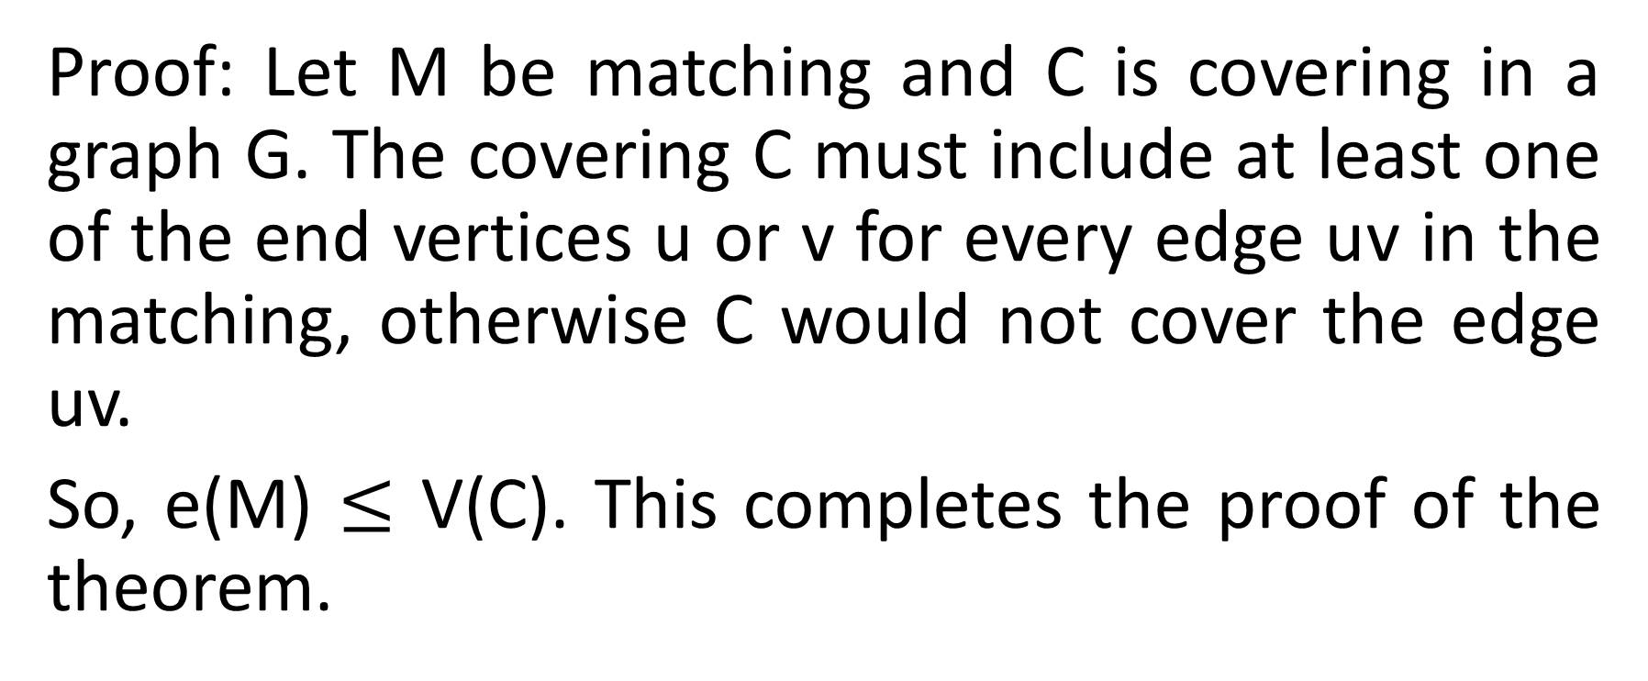
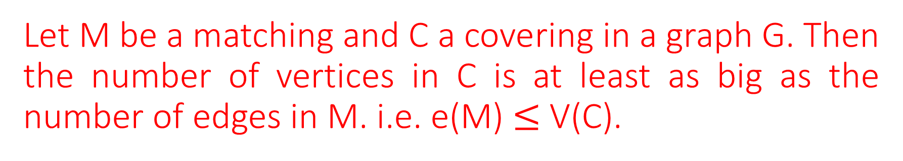
Let M be a matching and C a covering in a graph G. Then the number of vertices in C is at least as big as the number of edges in M. i.e. e(M) $≤$ V(C).
Proof: Let M be matching and C is covering in a graph G. The covering C must include at least one of the end vertices u or v for every edge uv in the matching, otherwise C would not cover the edge uv.
So, e(M) $≤$ V(C). This completes the proof of the theorem.

Slide 14
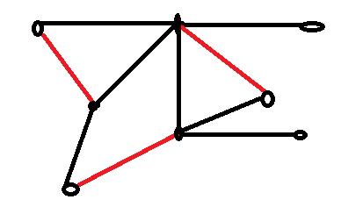

Let G be graph with size of matching e(M) and size of covering V(C). Discuss on e(M) $≤$ V(C) with required illustrations.
Solution: If we get a matching M and a covering C of the same size then we have e(M) = V(C) = 3 as shown in given figure.

Slide 15
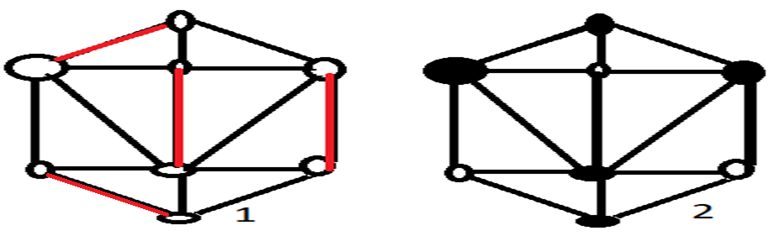
Continued…
But, some graph do not have same sizes of matching and a covering, for this, we take the following two graphs.

Slide 16
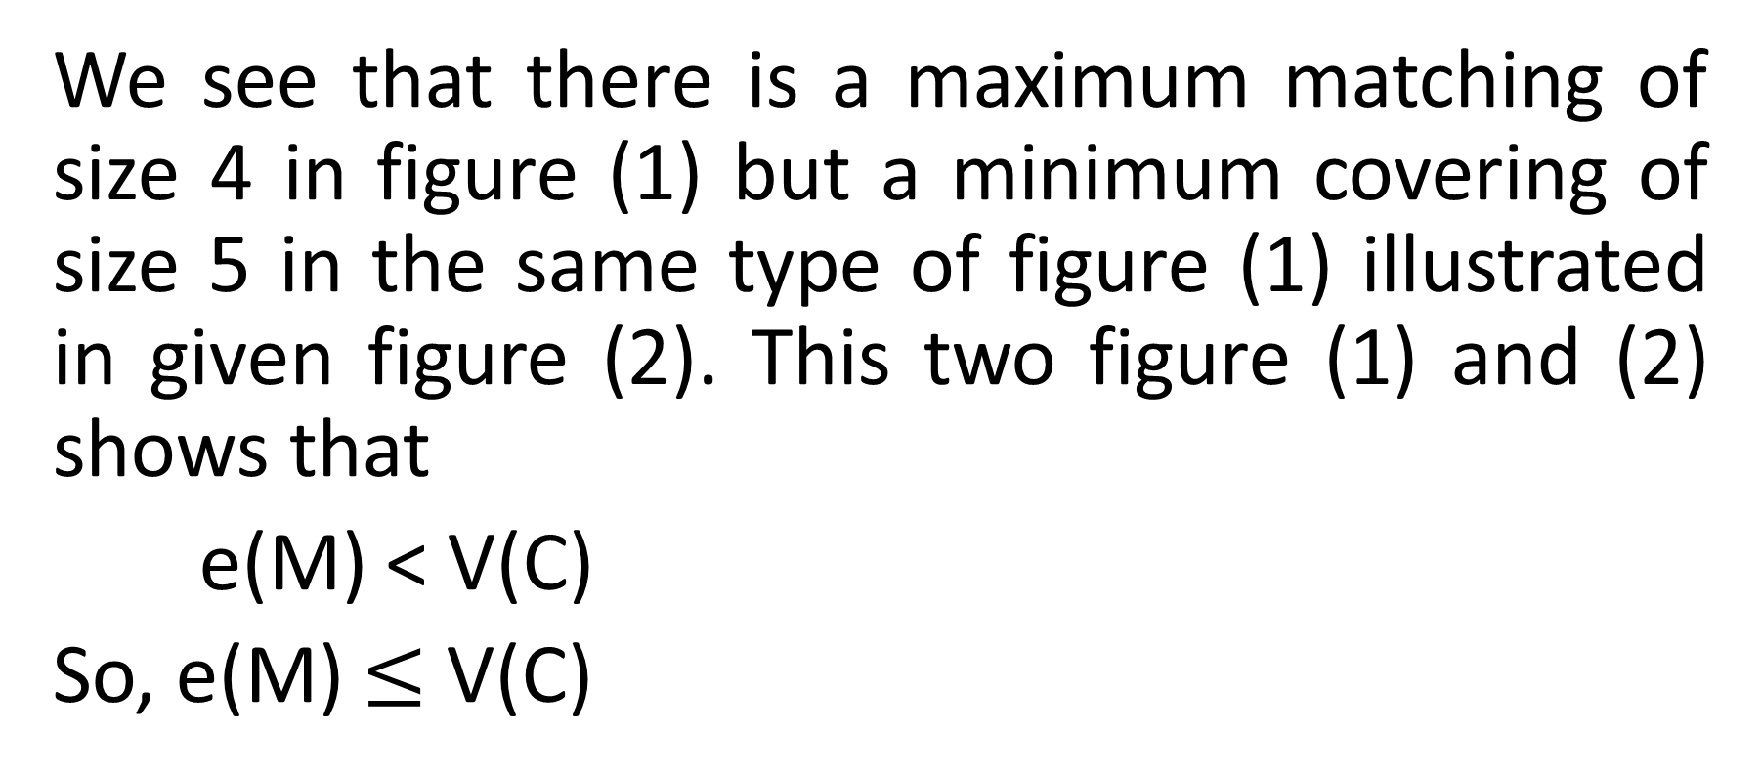
Continued…
We see that there is a maximum matching of size 4 in figure (1) but a minimum covering of size 5 in the same type of figure (1) illustrated in given figure (2). This two figure (1) and (2) shows that
e(M) < V(C)
So, e(M) $≤$ V(C)

Slide 17


